Slide 1
CHAPTER 8: Raspberry Pi and Firebase

Slide 2
Push data to Firebase: description
Take the apiKey, authDomain, databaseURL, storageBucket of the Firebase database
Create data as json form in Python
Data about user: firstname, lastname, age, university
Push the data to the database in Firebase

Slide 3
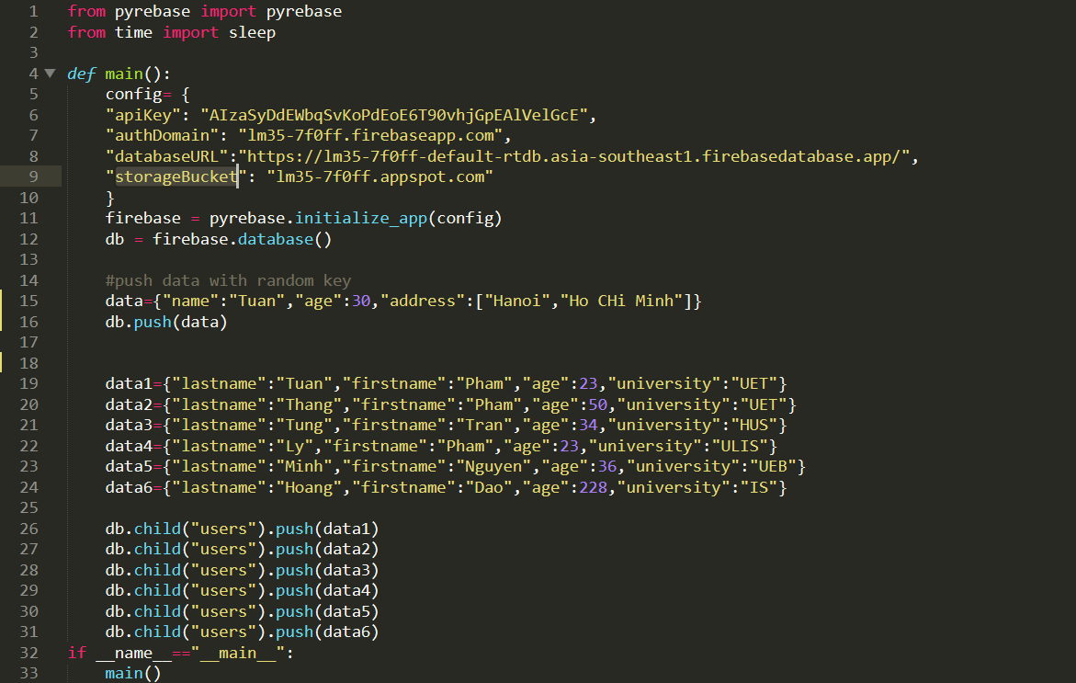
Push data to Firebase
Module: pyrebase, time
Initialize config of Firebase
Create data
Push the data to the database of Firebase

Slide 4
Edit data of own key child in Firebase: description
Take the apiKey, authDomain, databaseURL, storageBucket of the Firebase database
1
Initialize the database with own key child
2
Edit the data with function “update”
3

Slide 5
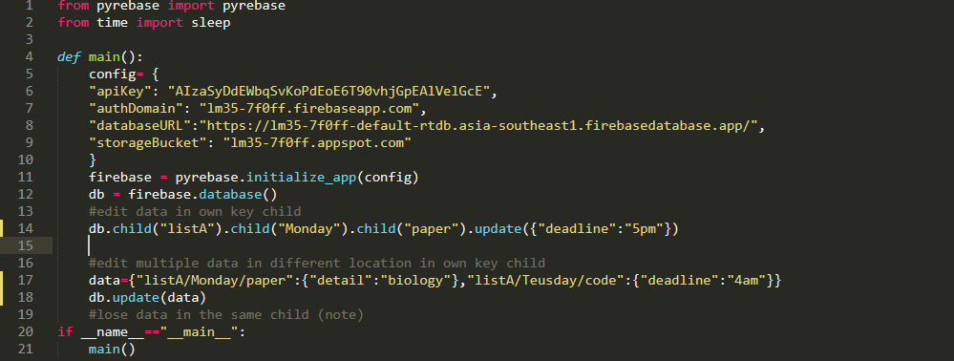
Edit data of own key child in Firebase
Module: pyrebase, time
Initialize config of Firebase
Use the own child key
Edit the data in the database of Firebase

Slide 6
Edit data of random key child in Firebase: description
Take
Take the apiKey, authDomain, databaseURL, storageBucket of the Firebase database
Initialize
Initialize the database
Create
Create variable task to access the object in the Firebase
Take
Take the value of each object (that is the random key)
Edit
Finally edit the data with the random key child and other childs

Slide 7

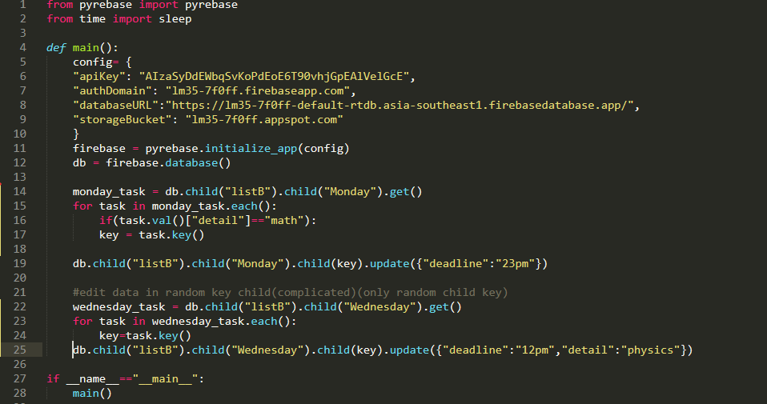
Edit data of random key child in Firebase
Module: pyrebase, time
Initialize config of Firebase
Access to the random key child
Edit the data with the random key child and other childs in the database of Firebase

Slide 8
Remove data of random key child in Firebase: description
Take
Take the apiKey, authDomain, databaseURL, storageBucket of the Firebase database
Initialize
Initialize the database
Create
Create variable task to access the object in the Firebase
Take
Take the value of each object (that is the random key)
Remove
Finally remove the data with the random key child and other childs

Slide 9
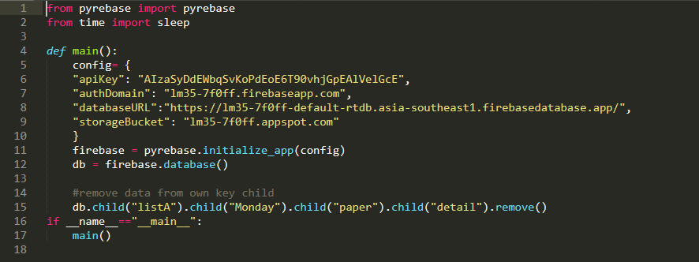
Remove data of own key child in Firebase
Module: pyrebase, time
Initialize config of Firebase
Use the own child key
Remove the data in the database of Firebase

Slide 10
Remove data of random key child in Firebase: description
Take
Take the apiKey, authDomain, databaseURL, storageBucket of the Firebase database
Initialize
Initialize the database
Create
Create variable task to access the object in the Firebase
Take
Take the value of each object (that is the random key)
Remove
Finally remove the data with the random key child and other childs

Slide 11
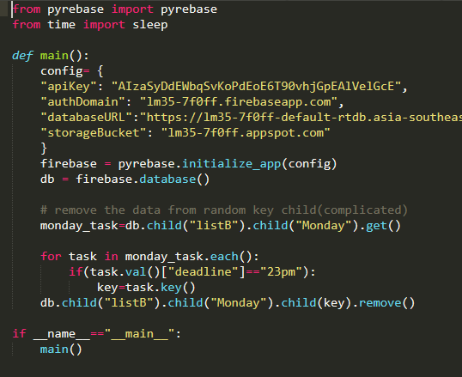
Remove data of random key child in Firebase
Module: pyrebase, time
Initialize config of Firebase
Access to the random key child
Remove the data with the random key child and other childs in the database of Firebase

Slide 12
Retrieve data of random key child in Firebase: description
Take
Take the apiKey, authDomain, databaseURL, storageBucket of the Firebase database
Initialize
Initialize the database
Create
Create variable task to access the object in the Firebase
Take
Take the value of each object (that is the random key)
Remove
Access with the data by list and dictionary

Slide 13
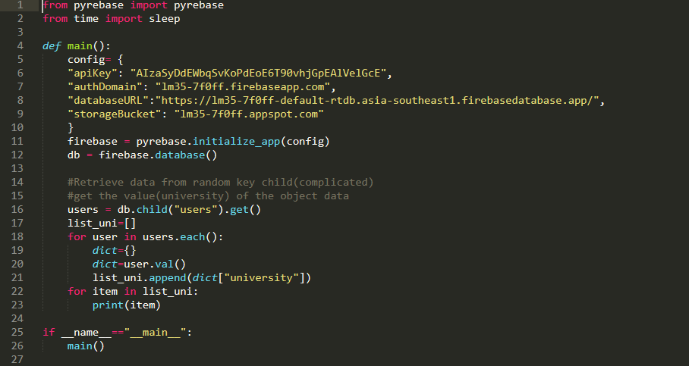
Retrieve data of random key child in Firebase
Module: pyrebase, time
Initialize config of Firebase
Access to the random key child
Acess the data in the database of Firebase by list and dictionary

Slide 14
Advance retrieve data from Firebase: description
Take the apiKey, authDomain, databaseURL, storageBucket of the Firebase database
Initialize the database
Use some function like: order_by_child, equal_to, limit_to_first/end, start_at and end_at to filter the data according to developer’s desire

Slide 15
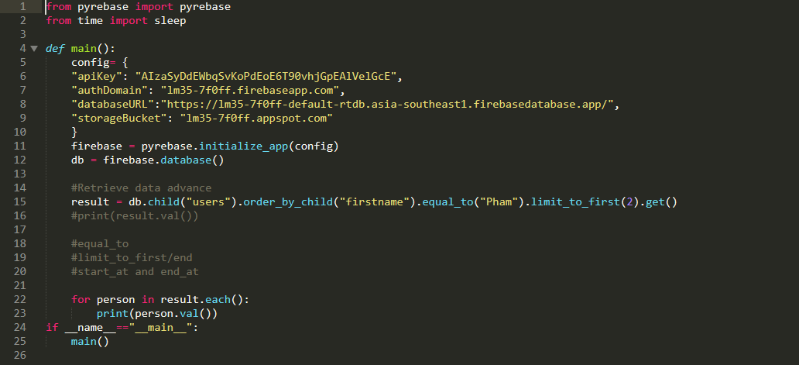
Advance retrieve data from Firebase
Module: pyrebase, time
Initialize config of Firebase
Access to the random key child
Use order_by_child, equal_to, limit_to_first function to sort data

